Slide 1
HT Programming
Dr. Herman Lam
Assoc. Professor of ECE
University of Florida
Yu Zou
Graduate Student

Slide 2
Outline
HT programming basics
CHREC framework
Merlin infrastructure
PERFMON code
User-friendly host API
DRE app. PageRank example

Slide 3
Outline
HT programming basics
CHREC framework
Merlin infrastructure
PERFMON code
User-friendly host API
DRE app. PageRank example

Slide 4
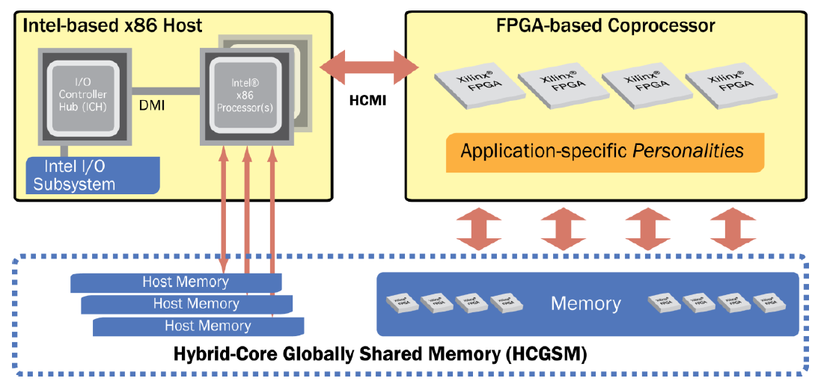
Convey HT Background
Convey computers
Startup since 2006, based @ Texas
Hybrid-core computing platforms
Joined CHREC in 2013
Via F3, focusing on bioinformatics app acceleration
Convey system philosophy – hybrid-core computing
Features | Convey
Programming | C/Cpp/ASM + HT + (HDL)
Data Addressing | explict, consistent
Host Connection | PCIe 2.0/3.0
HT : Hybrid threading - Convey’s HLS-like programming tool

Slide 5
Overview of HT Programming Model
Application “call-graph” structure

Slide 6
HT Infrastructure
Host-coproc. strucutre
Message/Data interfaces
HT unit
Replication mechanism
HT module
Essential functional blocks
Memory hierarchy
Can be replicated
Messaging interfaces among modules
Instructions
User-defined behaviors of modules

Slide 7
HT Toolset
Supported variable type
Private variable
Shared variable
Global variable
Supported data type
uint64_t, uint32_t
ht_uint1_t, ht_uint2_t, …, ht_uint64_t
ht_int1_t, ht_int2_t, … , ht_int64_t

Slide 8
User Programmable Parts
Host source files
Define program behaviors on the host, including data transmission, control flow, user interface, etc.
Hardware description files (.htd)
Declare modules, variables, memory interfaces, etc.
Module instruction files (.cpp)
Define behaviors of modules, including memory I/O, messaging interface, computation, etc.

Slide 9
High-level Design Flow

Slide 10
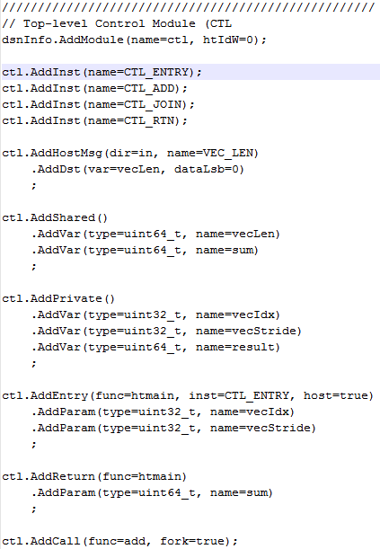
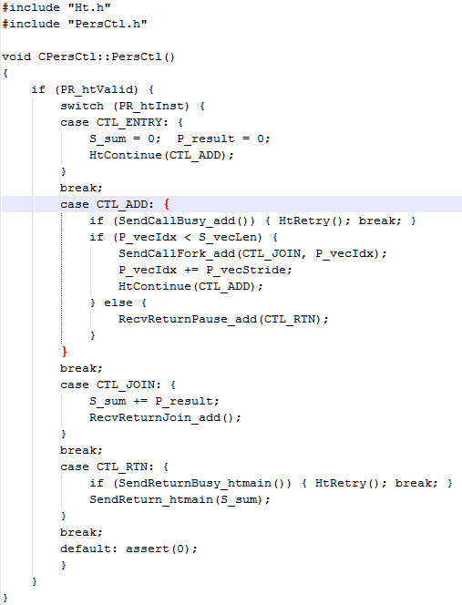
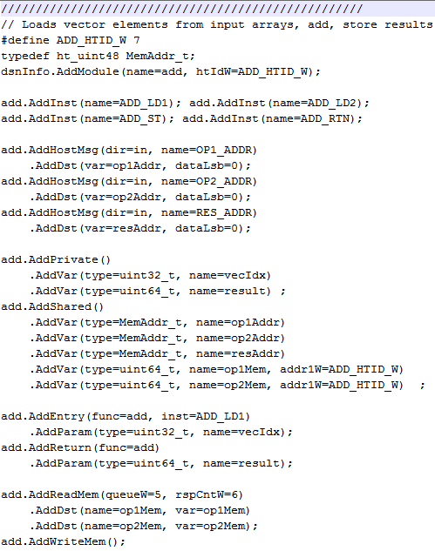
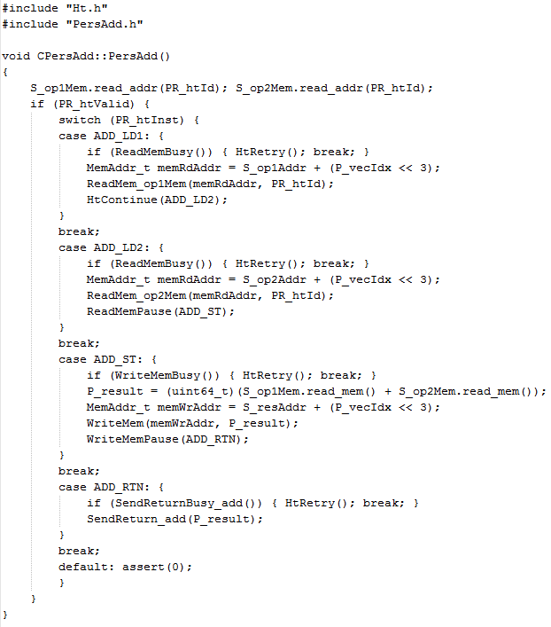
HT Code Example
Personality
HT Example: Vector-add personality
B
A
HT
Vadd Pers.
Add.htd
PersAdd_src.cpp
Ctl.htd
PersCtl_src.cpp
C
Thread control
Control (CTL)
1 thread
Memory Operations
Fn1
128 threads
Call to ADD module
ADD
Fn2
Fn3
Host message
Fn4
Variable declaration
Addition
Module I/O definition
Memory interface
Interface to other modules
HT tool flow
Personality with HT

Slide 11
Outline
HT programming basics
CHREC framework
Merlin infrastructure
PERFMON code
User-friendly host API
DRE app. PageRank example

Slide 12
Merlin Infrastructure
By reverse-engineering Verilog code
167 MHz (6ns/clk)
334 MHz (3ns/clk)

Slide 13
Key Components
HIX – host-FPGA interface
HIX_TLB
Translate virtual address from host to physical address
For host directly access HMC
CMC – HT logic

Slide 14
Key Components
Crossbar
Up to 16 HT units can be used
Route memory request from different units to corresponding memory controller
MC – there are 4 memory controllers

Slide 15
Key Components
MC_TLB
Translate virtual address from HT logic to phys. addr.
HMC_IF
Reformat memory request, e.g. adding tags
Group access to each vault and schedule priority

Slide 16
CHREC Framework v0.1 - HW
Achievements:
Added three clock counters: PERS_PERFMON, MC_PERFMON, HMC_IF_PERFMON
Modified based on PERFMON code provided by Convey/Micron
Memory access for board configuration were also counted
Filtered out irrelevant memory access, isolated memory access from HT logic

Slide 17
CHREC Framework v0.1 - HW
Achievements:
PERS_PERFMON
Roundtrip latency of HT logic memory request
MC_PERFMON
Roundtrip latency of access to memory controller
HMC_IF_PERFMON
The closest point to HMC that we can currently measure

Slide 18
CHREC Framework v0.1 - HW
Limitations
Only one memory controller and one HMCC are used
Inefficient use of HMC
Size of some FIFO is decreased to isolate memory access from HT logic
Not fully utilize HMC bandwidth
Ongoing work
Changing FIFO size to increase utilization of HMC bandwidth
To refine PERFMON code to enable all MCs and HMCCs in the future

Slide 19
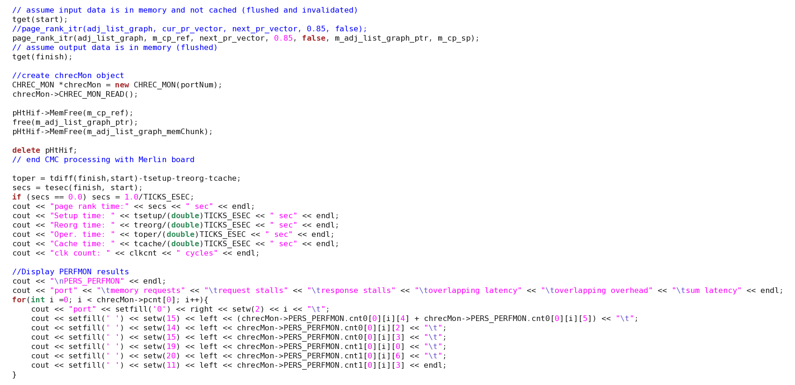
CHREC Framework v0.1 - SW
User-friendly API – CHREC_MON
Easy to read PERFMON data from FPGA
After completion of HT logic
Create a CHREC_MON object
Call CHREC_MON_READ() function
PERFMON data will be read and stored into corresponding arrays
Display

Slide 20
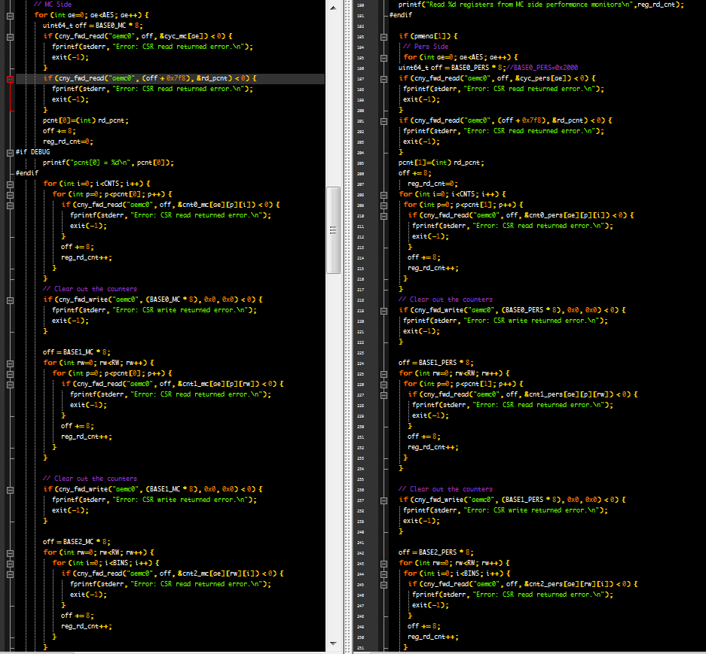
CHREC Framework v0.1 - SW
Original PERFMON host code provided by Convey/Micron

Slide 21
Outline
HT programming basics
CHREC framework
Merlin infrastructure
PERFMON code
User-friendly host API
DRE App. PageRank Example

Slide 22
DRE* setup, fill, drain
void setup(value_pointer refp, index_pointer indexp, value_pointer sp)
{
ref_base = refp;
idx_base = indexp;
scratchpad = sp;
}
void fill() {
for (size_t i = 0; i < scratchpad.length(); i++) {
scratchpad[i] = ref_base[idx_base[i]];
}
}
void drain() {
for (size_t i = 0; i < scratchpad.length(); i++) {
ref_base[idx_base[i]] = scratchpad[i];
}
}
*Data Reordering/Rearrangement Engine by Lawrence Livermore National Lab

Slide 23
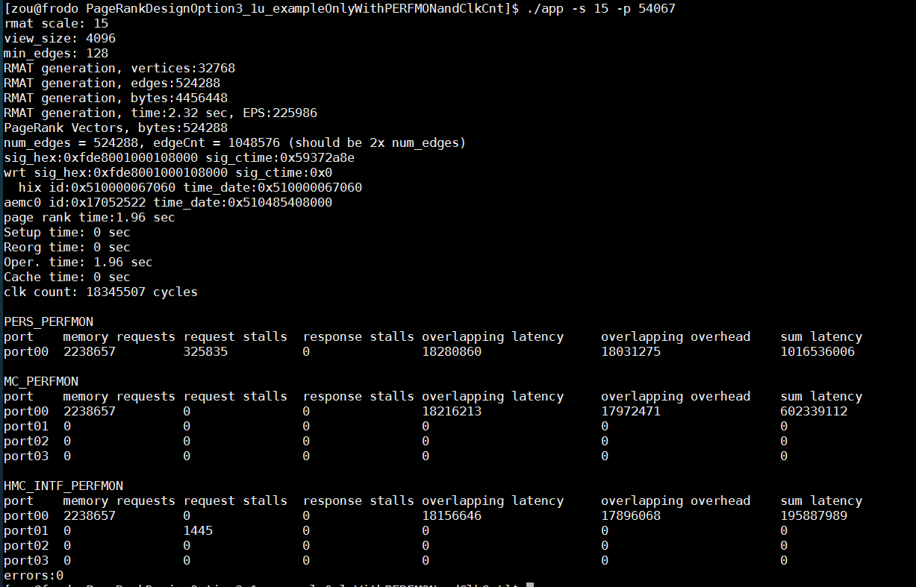
DRE PageRank Example
./app –s 15 –p 54067
Host is using TCP/IP to access PERFMON data, port number is required

Slide 24
Appendix

Slide 25
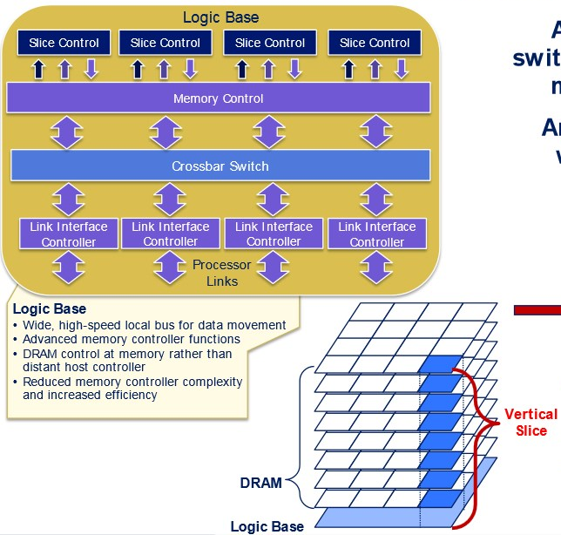


Introduction
Hybrid memory cube
High-performance RAM interface for through-silicon vias (TSV)-based stacked DRAM memory
Logic base (layer)
High bandwidth
~10% energy per bit of current DDR memories

Slide 26
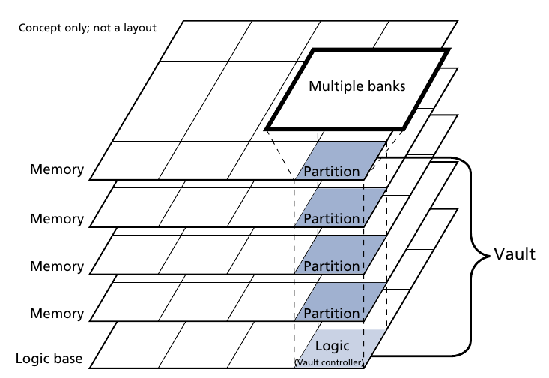
Advantage of HMC
High bandwidth comes from internal parallelism
Vaults can be accessed in parallel
Banks can be accessed in pipeline
But not enough ! ! !
Pins constrain max. bandwidth
Bottleneck for data-intensive
apps
Big data, e.g. PageRank
Gnome research, e.g. DNA
sequencing

Slide 27
High Bandwidth of CMC
HMC configuration
16 HMCs are chained together
Size – 8 GB
64 bit vertical interface each DRAM partition
32 vaults per cube
TSV signaling rate 2 Gb/s
8 high-speed external serial links
Available external bandwidth – 320 GB/s
Available internal bandwidth – 8 TB/s
25x

Slide 28
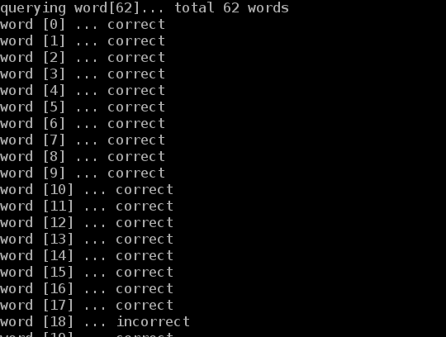
Bloom Filter HT Demos
Spell checker
Input
A dictionary
Words to check
Function
A bloom filter was pre-set using the dictionary
A new word was compared against bloom filter to check existence in the dictionary
Output
A wrong spelling is reported if the new word doesn’t exist in bloom filter
HT utilization
1 HT unit

Slide 29
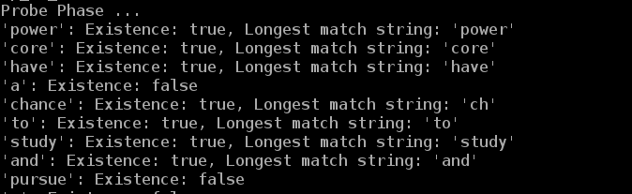
Bloom Filter HT Demos
Content-based deep packet inspection (longest string match)
Input
A group of different-length sensitive words
Packet to inspect
Function
All same-length sensitive words are used to set the same bloom filter
Multiple bloom filters are pre-set
A new packet is compared against bloom filters to check existence of sensitive words
Output
Report the packet contains sensitive information, if matched
HT utilization
16 HT units

